Slide 1
Multi-Threading & Thread Life Cycle
By Abhishek Gupta

Slide 2
Thread
Smallest sequence of programmed instructions that can be managed independently by a scheduler (typically as part of an operating system).

Slide 3
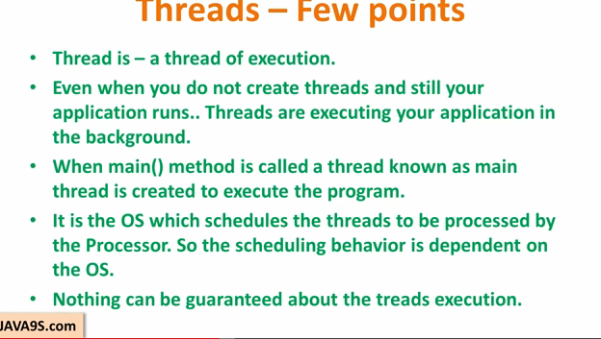

Slide 4
MULTITHREAdING
Contains two or more parts that can run concurrently.
Each part can handle different task at the same time making optimal use of the available resources.
Multi threading extends the idea of multitasking into applications where you can subdivide specific operations within a single application into individual threads. Each of the threads can run in parallel.
Multi threading enables you to write in a way where multiple activities can proceed concurrently in the same program.
Multithreading enables you to write very efficient programs that make maximum use of the CPU, because idle time can be kept to a minimum.
Java has built in thread support for Multithreading

Slide 5
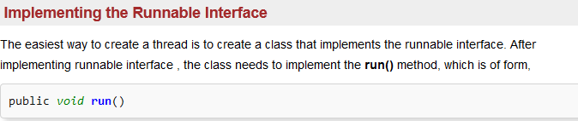
Two ways for Thread creation

Slide 6
public class thread1 implements Runnable{
@Override
public void run()
{
System.out.println("hello world");
}
public static void main(String args[]) {
//(new Thread(new hello_thread())).start();
Thread t=new Thread(new thread1());
t.start();
}
}

Slide 7



Slide 8
public class thread2 extends Thread{
public void run()
{
System.out.println("helloworld");
}
public static void main(String[] args)
{
thread2 t=new thread2();
t.start();
}
}

Slide 9
Thread class vs. runnable interface
THREAD CLASS | RUNNABLE INTERFACE
By extending thread class, the derived class itself is a thread object and gains full control over the thread itself. | Does not give developer any control over the thread itself, as it simply defines the unit of work that will be executed in a thread.
The derived class cannot extend any other base classes because Java only allows Single inheritance. | Can extend other base classes if necessary.
If program needs a full control over the thread life cycle. | If the program need more flexibility of extending other base classes.

Slide 10
Thread Priorities
There are priorities for some of the methods which work on the thread priority.
SetPriority()
Priorities range from 0 to 10.
MIN_PRIORITY(0),NORM_PRIORITY(5), MAX_PRIORITY(10)
GetPriority() : This method is used to get the priority of the thread.

Slide 11
Thread Methods
IsAlive(): returns a true or false.
join(): this method waits until the thread on which it terminates. Its name comes from the concept of calling thread waiting until the specified thread joins it.
suspend(): pauses the execution.
resume(): restart the execution.
destroy(): kill the method.
activeCount(): returns the number of active thread in a thread group.
interrupt(): Interrupts the thread.

Slide 12
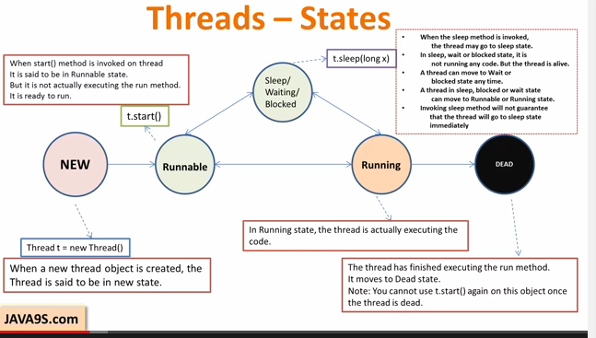
THREAD LIFE CYCLE

Slide 13
Example
Calc_main
calc_add
calc_min
cal_mult

Slide 14
Reference
http://www.tutorialspoint.com/java/java_multithreading.htm
Multithreading, M. Raihan, Computer Science and Engineering Discipline , Khulna University
JAVA9s.com

